Slide 1
Arduino Uno Traffic Lights
Instructed by teacher:” Mohammad Tahir”
Prepared and worked by:”Aziz Ahmad Afzali and Haroon Sahibzada”
Aziz Ahmad Afzali ID:201-2204033
Haroon Sahibzada ID: 201-2204124

Slide 2
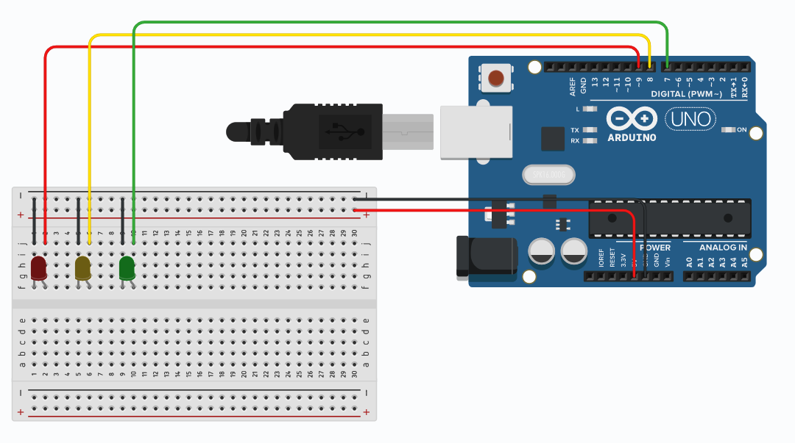
Circuit Diagram:

Slide 3
Components and tools to make traffic lights:
3 LED (Red, Yellow, Green)
Jumper Wires M-M
3 Resisters
Breadboard(generic)
Arduino UNO

Slide 4
CODE:
Code:
int red = 9;
int yellow = 8;
int green = 7;
void setup(){
pinMode(red, OUTPUT);
pinMode(yellow, OUTPUT);
pinMode(green, OUTPUT);
}
void loop(){
digitalWrite(red, HIGH);
delay(15000);
digitalWrite(red, LOW);
digitalWrite(yellow, HIGH);
delay(1000);
digitalWrite(yellow, LOW);
delay(500);
digitalWrite(yellow, HIGH);
delay(1000);
digitalWrite(yellow, LOW);
delay(500);

Slide 5
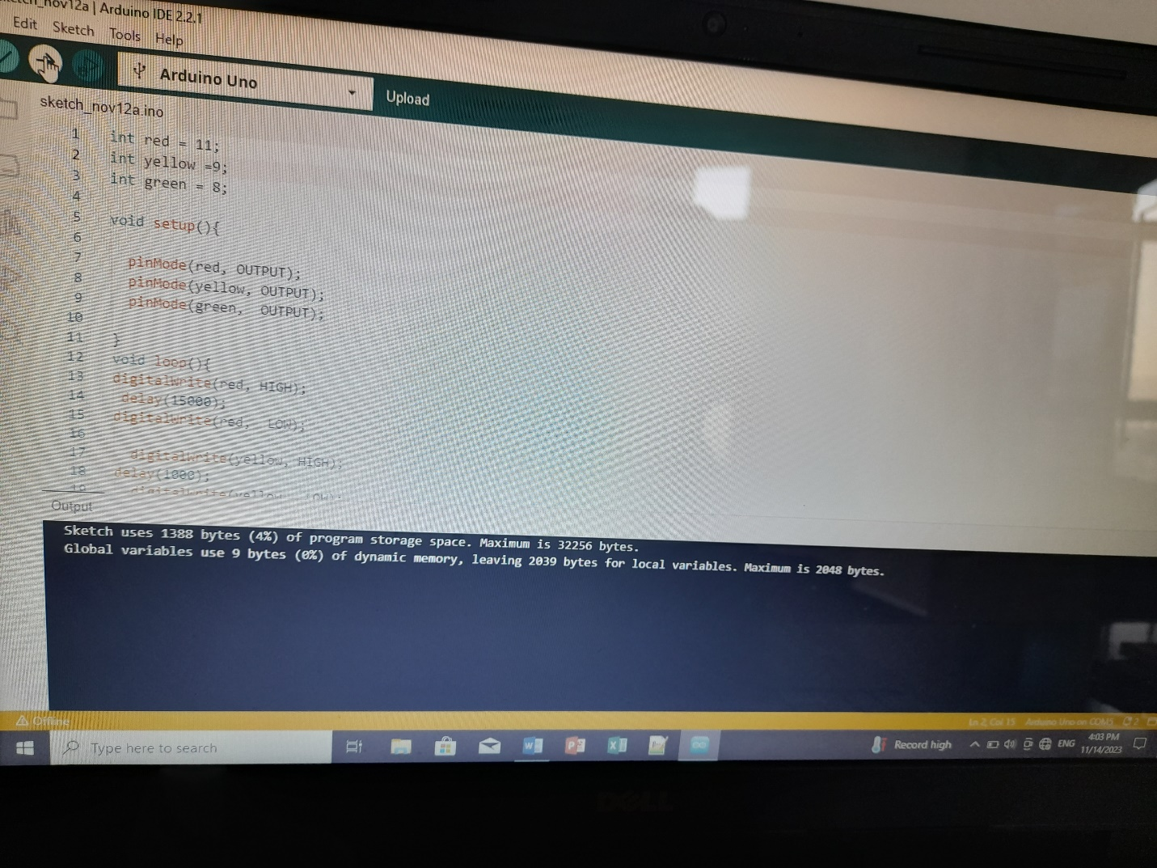
Running of the code:

Slide 6
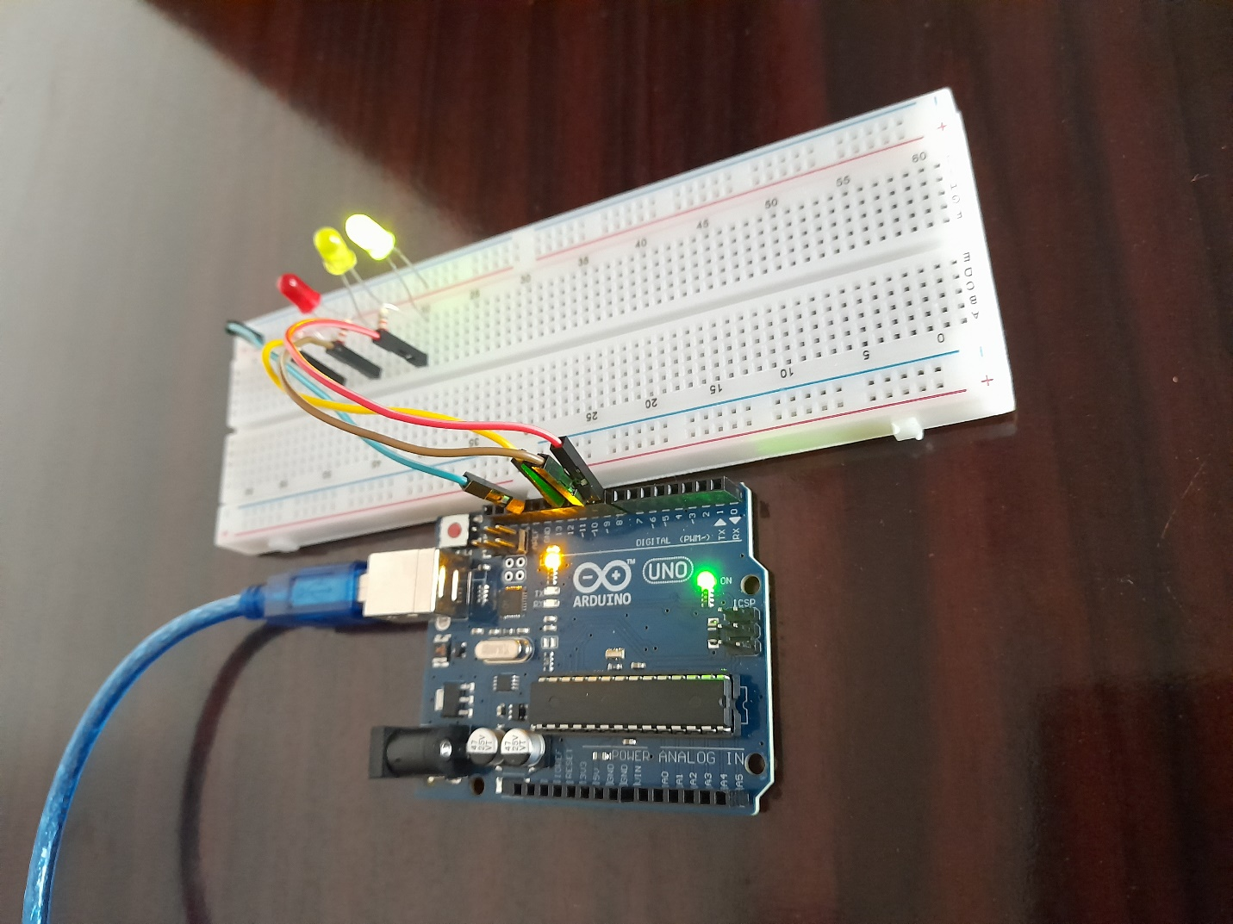
Hardware of Traffic lights

Slide 7
Thank you

